Slide 1


Open Community
Welcomes You All
Open Community
FOR
“Uncovering RPA and UiPath”

Slide 2

WHO ARE WE?
On 18th Jan 2019 with the support of various global IT giants and organizations of repute including STPI, Xebia, IBM and TechMint.
Working on open source projects that lead towards various advancements and innovation by providing the right support and mentorship to students is our motto.
Our Motto – Aware , Adopt and Contribute
Visit our Official Website: https://upes-open.org/

Slide 3
AGENDA GETTING STARTED WITH RPA AND UIPATH

Slide 4


SPEAKER’S INTRO
Medhavi Singh
Project Dev. Lead – Open Community
2022-23 UiPath Student Champion
UPES Dehradun

Slide 5
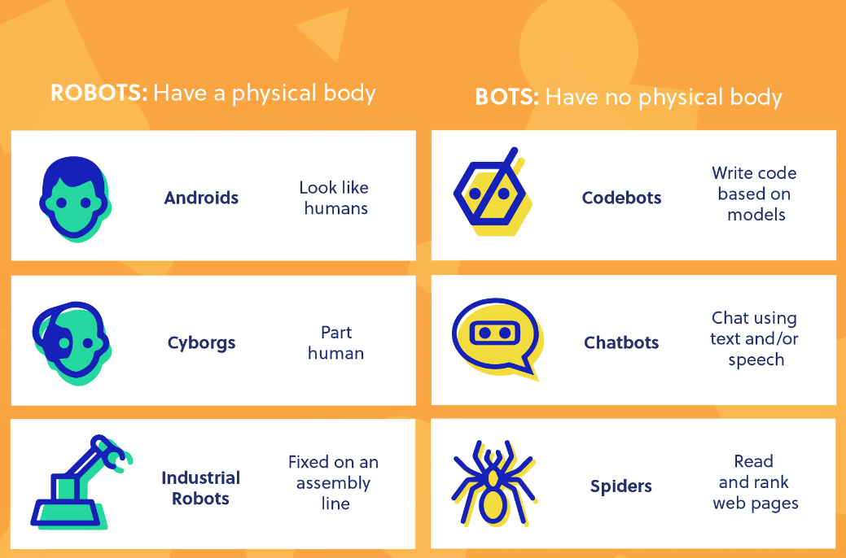
ROBOTS VS RO(BOTS)
Image Credit: Codebot.com
Notes:
What’s interesting are the parallels between androids, robots that look like humans and chatbots, and bots that act like humans.
https://youtu.be/sk1NkWl_W2Y
A cyborg is a human-robot hybrid.
Industrial robots are the robots you see in assembly lines. They are designed to move materials, parts, and tools to complete programmed tasks in manufacturing and production.
They are commonly used to complete duties that are dangerous or unsuitable for human workers.
Originally, “bot” was a shortened version of “robot”, but now it means robots without bodies.
Robots are programmable machines that can automatically execute actions, whereas bots are programs that can automatically execute actions.
A chatbot can live inside a range of existing products/services, such as Facebook Messenger and iPhone (i.e. Siri), or in a custom-made machine, such as Google’s Home device.
A web crawler, or spider, is a type of bot that is typically operated by search engines like Google and Bing. Their purpose is to index the content of websites all across the Internet so that those websites can appear in search engine results.
https://www.cloudflare.com/learning/bots/what-is-a-web-crawler/
https://codebots.com/docs/as-a-developer-why-use-a-codebot

Slide 6
https://youtube.com/shorts/OiUVOnuIHlM?feature=share

Slide 7
Introduction to RPA

Slide 8





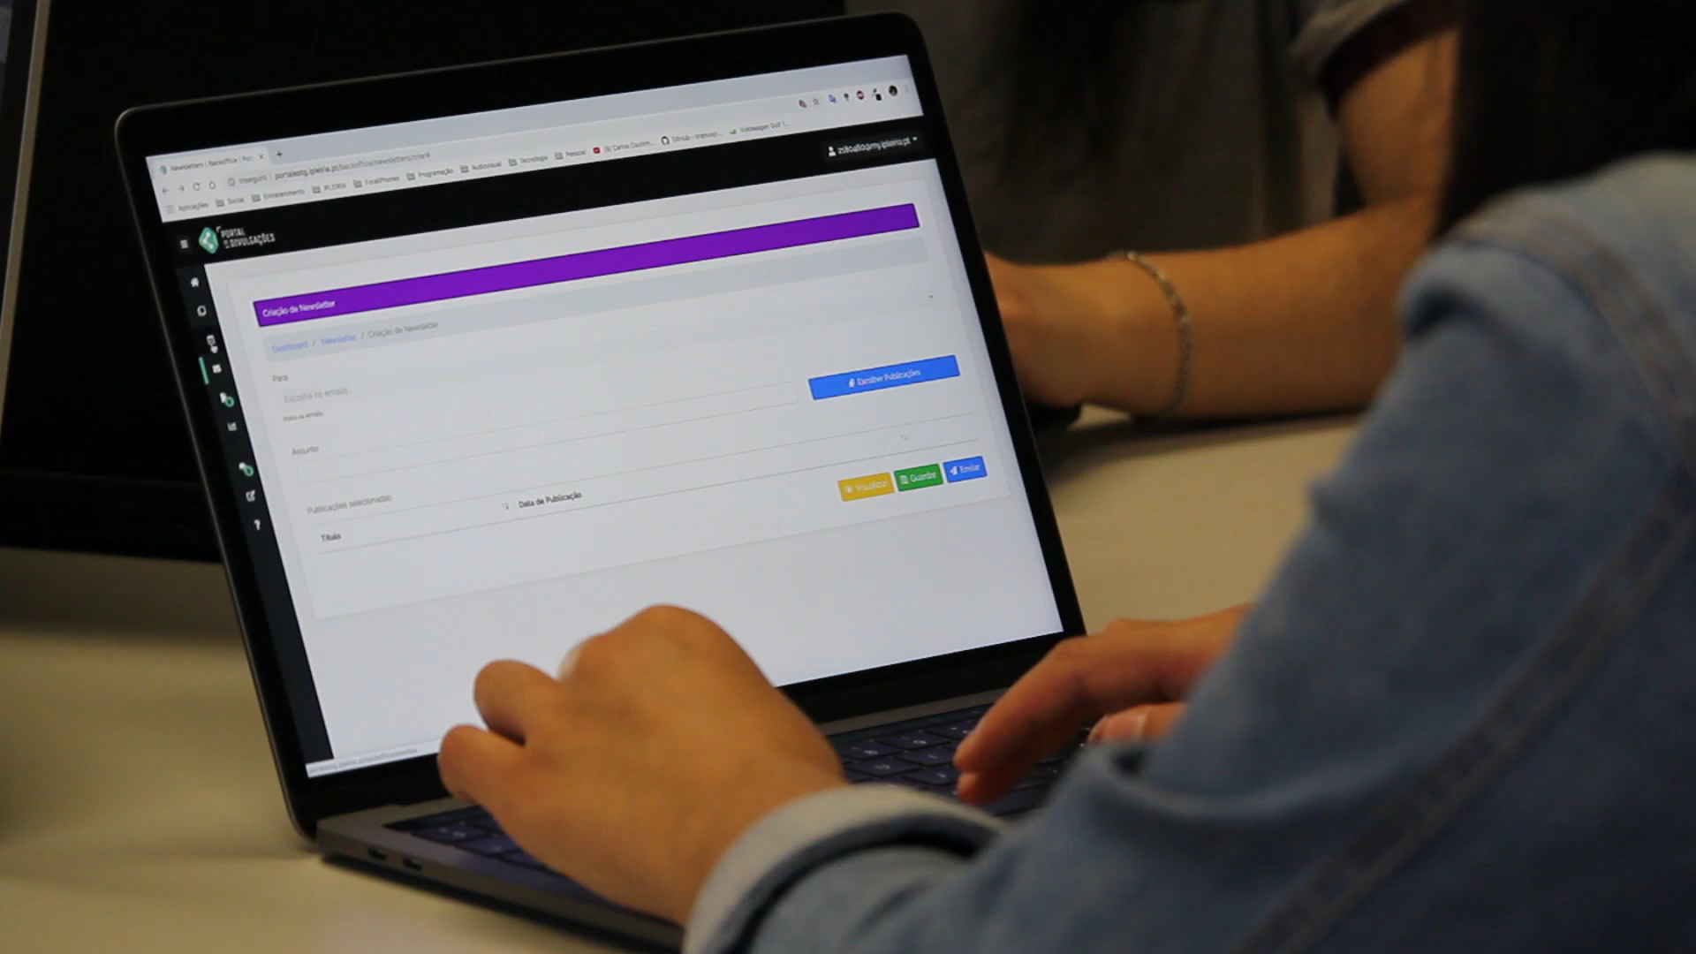
What is RPA?
RPA is the technology that enables a software program to mimic human actions while interacting with computer applications to accomplish required tasks. Some human interactions that can be automated are:
Keyboard inputs
Mouse movements and clicks
Reading computer screen

Slide 9
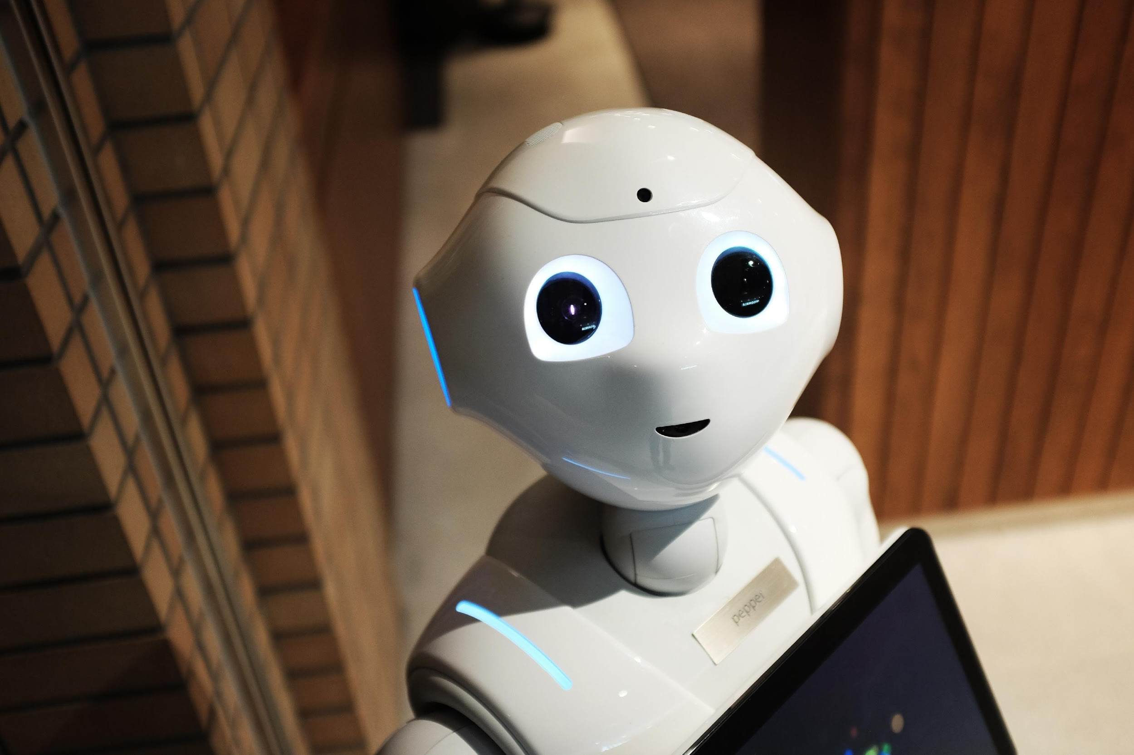
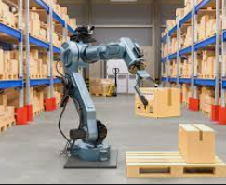
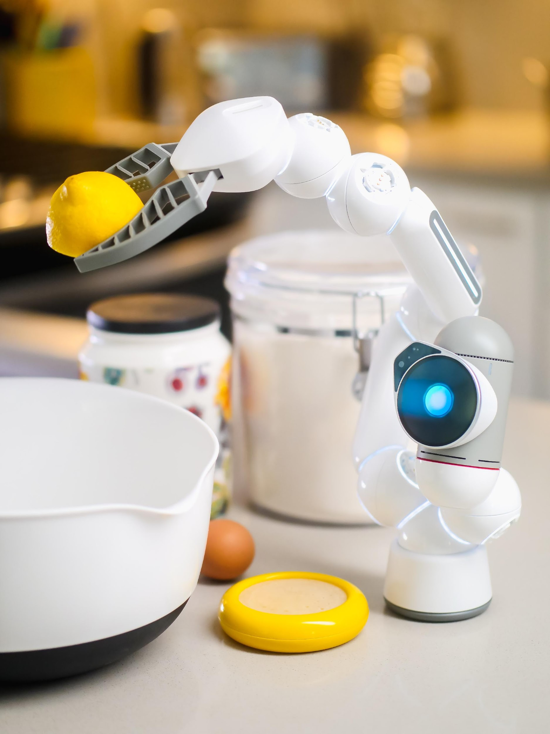
What RPA is not?
Walking and Talking Robots or Humanoid
Warehouse Robots
Human Replacements

Slide 10
What is RPA?
Mimics human action
Quick to implement and powerful to scale
Operates any application
RPA
No mistakes and without resting
Structured reading and actioning data
Notes:
Simply put, RPA or robotic process automation, is the technology that enables computer software to emulate and integrate actions typically performed by humans interacting with digital systems.
The key aspects of RPA are:
- mimicking human actions – RPA aims at automating what humans can do with their hands and eyes. Or how we like to say it, we want to take the robot out of the human;
- operating any application – we believe that, as long as a human can operate an app, a robot should be able to do it as well. It’s not the easiest thing all the time, but it’s our credo;
- structured reading and actioning data – repetitive work with data opens the path to storing all the data that a robot handles and re-using it in other applications, as well. Sometimes humans use their knowledge to solve tasks, but the data is not captured. With robots, everything can be kept and re-used;
- No mistakes and without resting – once a robot has been configured to follow a process, it will not grow tired and won’t take any liberties regarding the steps in the process. It will not get bored;
- Quick to implement and powerful to scale – RPA generally doesn’t need changes in the architecture. Moreover, if a robot does it, there isn’t any reason for getting as many robots as you need to do all the similar work.

Slide 11
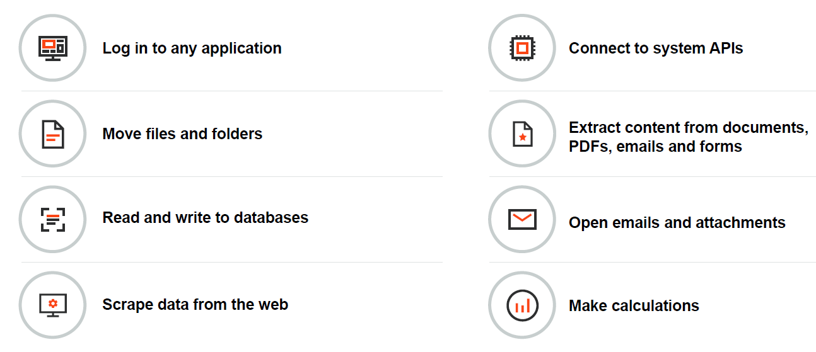
What Robots Can Do ?

Slide 12
Benefits of RPA
The major advantages of RPA adoption by a business are:
Increased Execution Speed
Enhanced Accuracy
Improved Regulatory Compliance
Reduced Cost of Process Execution
Easier Scaling

Slide 13
Why RPA?

Slide 14
Everest Group
Everest Group
** IDC study The Economic Impact of UiPath Robotic Process Automation: $55 Billion a Year by 2025

Slide 15
Why RPA?
RPA is the fastest growing category of Enterprise Software (growing at 65% CAGR according to ForresterTM)
Global Robotic Process Automation (RPA) market is still on track to see double-digit growth from 2020 to 2021—19.5%, to $1.89 billion—according to a recent Gartner press release

Slide 16

RPA Developer Talent Pool & Demand for skills
Talent Pool Overview
Total Professionals | Changed Jobs | Job posts
168,547 | 43,606 | 16,446
Top locations for talent
32%
Top Cities with Talent | Changed Jobs
Cities | Professionals | Last 1 Year growth | Average $**
1.Bengaluru | 12,172 | 26% | ₹5.1 Lakh
2. Delhi | 6,468 | 27% | ₹5.1 Lakh
3. Chennai | 6,000 | 32% | ₹5.1 Lakh
4. Hyderabad | 5,761 | 38% | ₹5.1 Lakh
5. Pune | 5,131 | 30% | ₹5.1 Lakh
6. Mumbai | 4,543 | 32% | ₹5.1 Lakh
7. Singapore | 3,826 | 32% | $70K SD
8. New York | 2,965 | 18% | $109K
9. London | 2,702 | 14% | £47,5K
10. São Paulo | 2,266 | 44% | R$13,022
Top Employers India
Accenture
Tata Consultancy Services
EY
Deloitte
Cognizant
* Based on Linkedin Talent Report for UiPath, generated in July 2022

Slide 17







Use of RPA in Business
Some examples where RPA is deployed in businesses departments today are:
Education
Supply Chain
IT
HR
Enrolment Process
Attendance Robot
Scheduling Meetings
Classroom and Online Learning
Answering Queries
Library Robots - Alerts
Inventory management
Invoice & contract management
Server & app monitoring
Routine maintenance & monitoring
Payroll
Onboarding & offboarding
Client Services
Accounting
Operations
Address change
Scheduling appointments
Accounts/Reports Reconciliation
Account Creation & Update
Order Creation & Update
Work Order Request

Slide 18
Why UiPath?

Slide 19

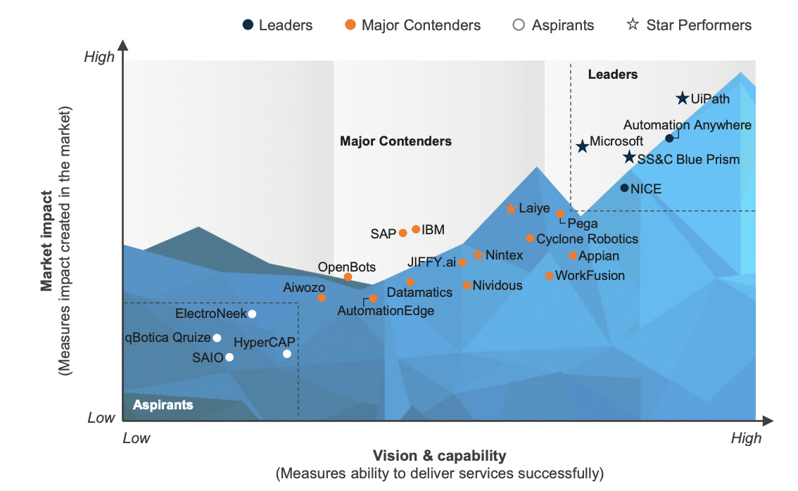
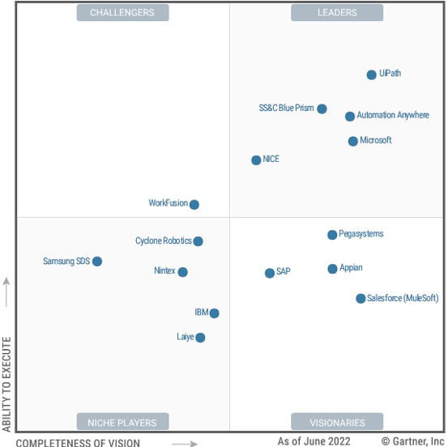
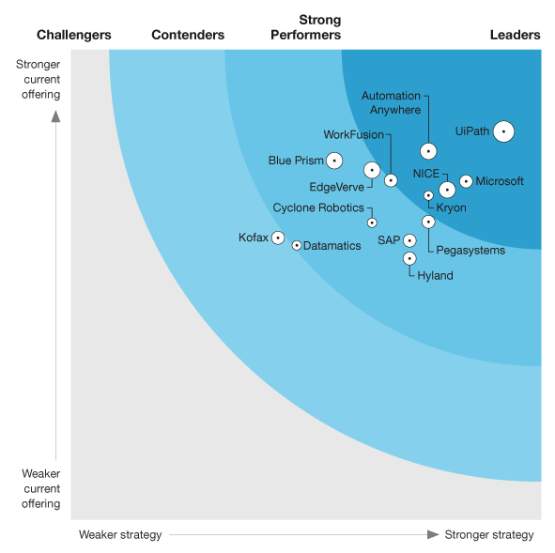
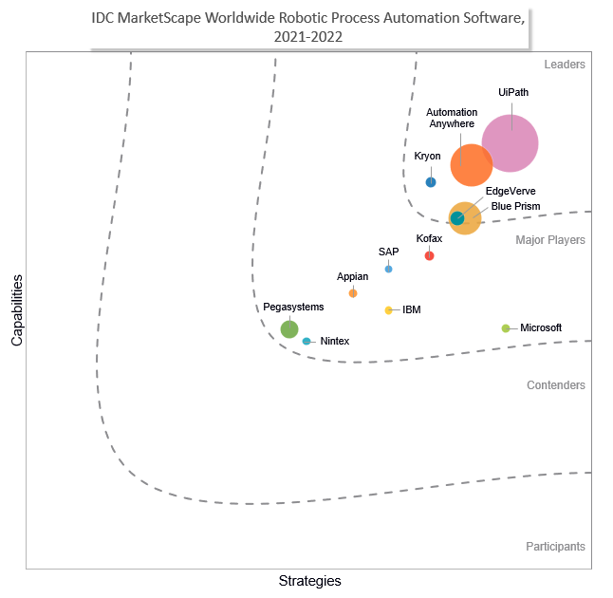
Why UiPath
Analysts: UiPath leads in product, vision, strategy and execution
Gartner
Forrester
IDC
Everest
Gartner and Everest, 2022; other reports, 2021

Slide 20

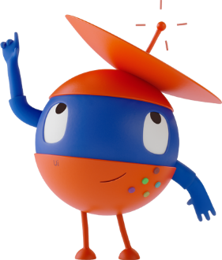
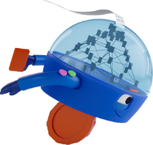
Automation & us
Evolving with speed to accelerate human achievement
Series A
Investment
Our Mission: To deliver the
Fully Automated EnterpriseTM
Our Vision: A Robot for Every Person
Headquarters in New York City
Leader in Gartner Magic Quadrant and Forrester Wave for RPA
#1 in Gartner Magic Quadrant
UiPath founded in Romania
Public company
UiPath Enterprise RPA Platform
Series B & C
investment
Acquired Re:infer
Series D investment
Series F investment
#1 in all major independent user review sites for RPA
Series E investment
STUDIO
ORCHESTRATOR
ROBOTS
AI COMPUTER VISION
AI CENTER
PROCESS MINING
HUMAN
IN THE LOOP
AUTOMATION CLOUD
APPS
SCREEN
SCRAPING
UI AUTOMATION
OCR
TEST SUITE
STUDIOX / ASSISTANT
TASK MINING
2017
2018
2019
2020
2021
2022
2005
2013
THE FULLY AUTOMATED ENTERPRISE

Slide 21

Today: global coverage, local expertise
Toronto
London
Bellevue
Boston
Amsterdam
NYC HQ
Munich
Mumbai
Austin
Paris
D.C.
Bucharest
San Jose
Tokyo
Houston
Bangalore
Hong Kong
Dubai
Seoul
Singapore
Sao Paolo
Sydney
Notes:
This map changes frequently as we are always expanding worldwide
These are the offices we have worldwide
Product development centers: Bellevue, Bucharest and India
Customer support centers: Bucharest and India
Sales, marketing and RPA consultants in all other offices
Head offices at 90 Park Ave in New York City

Slide 22



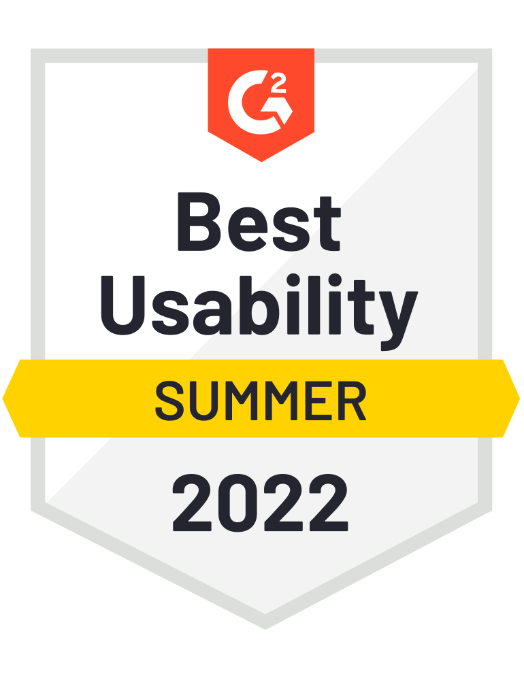

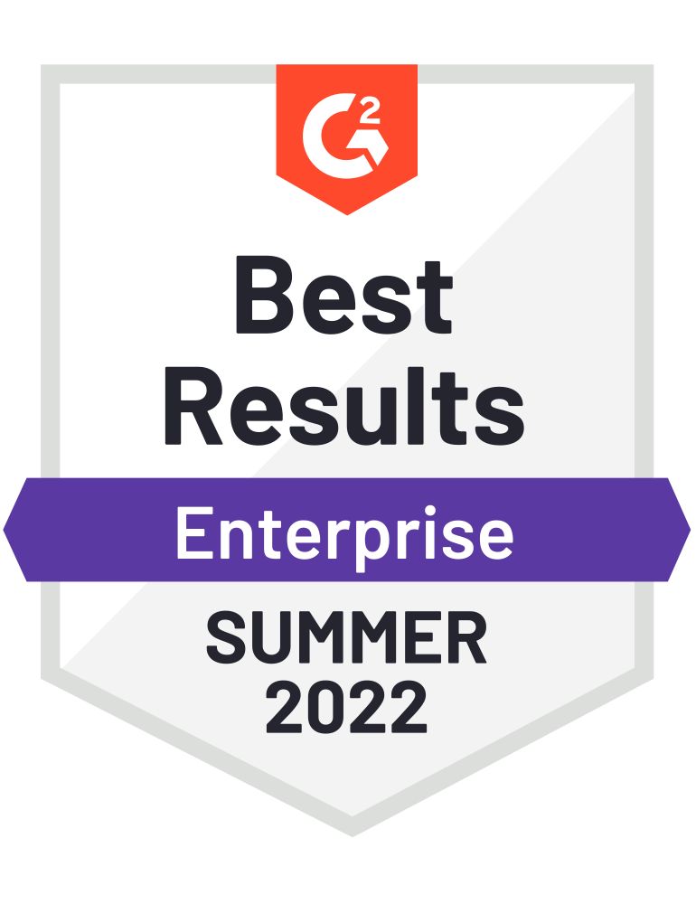
Users: The UiPath Platform is top-rated
G2
Gartner Peer Insights
Peer Spot
Trust Radius
SoftwareReviews
4.6 out of 5
4.5 out of 5
Peer Spot Award
Top-Rated RPA Software
Top-Rated RPA Solution
Aggregate rating 2022
Aggregate rating since inception
2021
2021
2021
Leader in RPA:
Winner 2021 Emotional Footprint Award
#1 Value for Price (in RPA category)
Customers’ Choice Winner, 2021
Leader in Low-Code
Leader in Test Automation

Slide 23



UiPath Platform
The UiPath Suite has three core components, which are are:
Studio
Orchestrator
Robot
Deploy
Execute
Design automation workflows visually, with minimal use of code
Control, manage and monitor the robots
Execute workflows and instructions

Slide 24

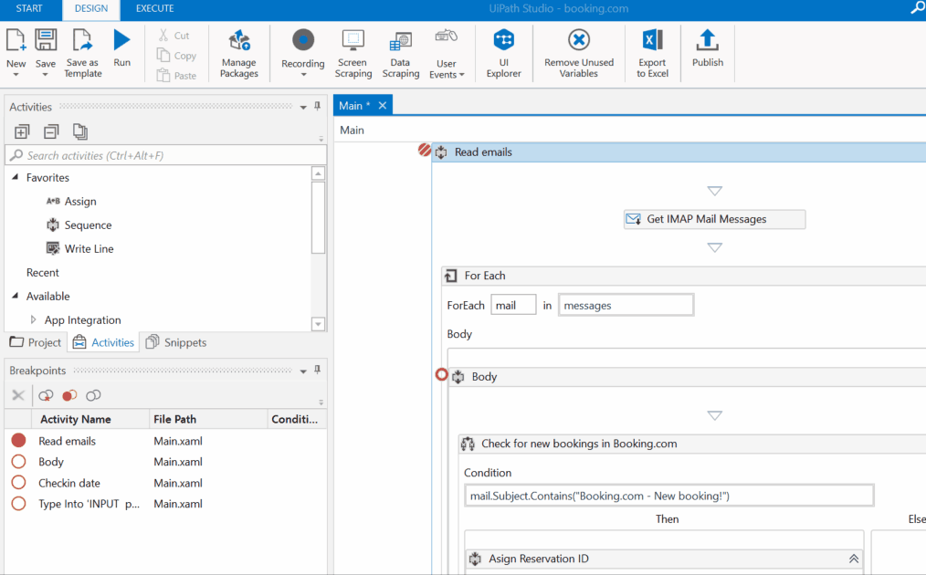
Where RPA Developers design automations visually, building any kind of automation from simple tasks to robots enhanced with AI skills. Its Powerful, user-friendly IDE, to visually design your automation

Slide 25

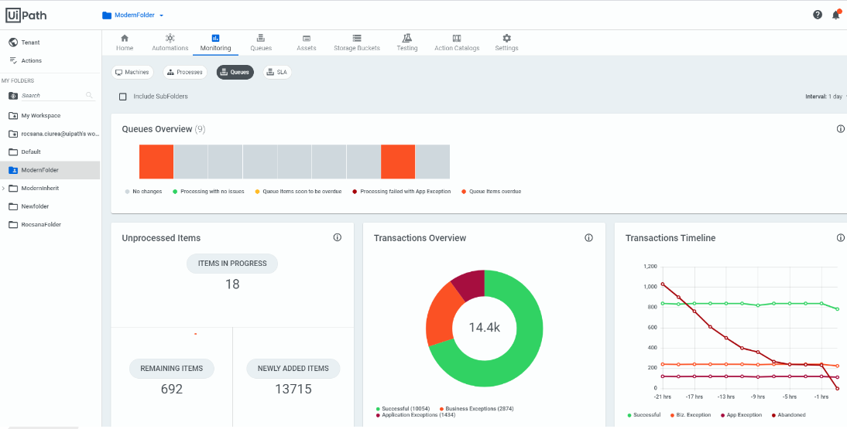
Orchestrator is the heart of your automation management. It gives you the power to deploy, trigger, monitor, measure and track every robot.

Slide 26

Run your automations from a desktop, data center, or the cloud
Robots are your digital helpers.
No Robots
Attended, In Tandem
Hybrid
Fully Unattended
UiPath software robots are intelligent, reliable, flexible, and eager to take on a huge range of tedious tasks.
100% human
Human on computer with Robot process in background
Attended process uses human’s computer to kick off unattended background process
100% automation
Choose attended, unattended, or a bit of both (hybridmodel).
Examples:
Brainstorm with your team
Examples:
HR Robot works with onboarding team to provision a new employee
Examples:
Service Rep turns on Robot to delete customer data from multiple databases as part of a GDPR "right to forget" request
Examples:
Robot processes invoices
Robot loads data into a system like SAP
You decide how your robots work for you...
Attended Robot
Unattended Robot

Slide 27
UiPath Community Programs

Slide 28
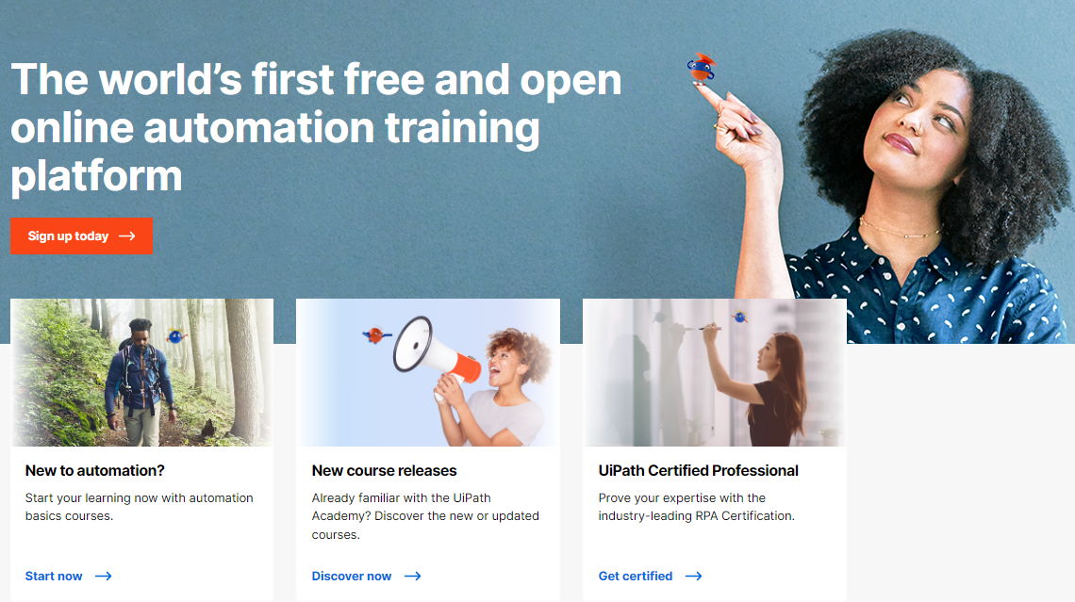
UiPath Academy
The UiPath Academy empowers you to grow as a professional and reach new heights in the digital era by providing latest study materials on RPA.
Open online platform offering free RPA training
Helps you to progressively build your automation skills with the help of a variety of courses
Take on-demand courses, enroll in role-based learning paths, and get comprehensive product training.
To Know more visit… https://academy.uipath.com/

Slide 29
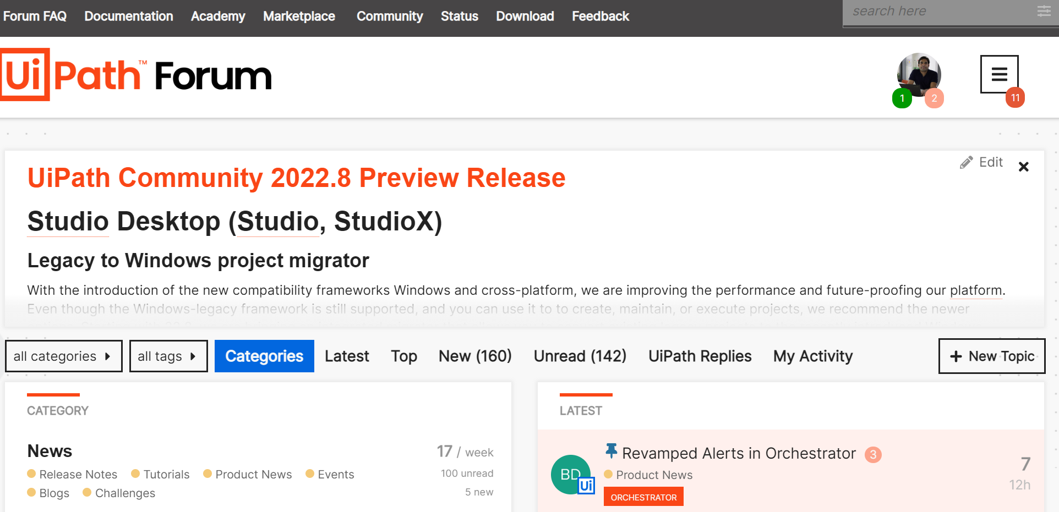

UiPath Forum: A place for UiPath developers to get help and stay updated!
We're glad you found us, here you can get crowdsourced support and give product feedback on how to make our products better. Here you'll find all the information you need about our products, as well as ways to contribute to help us improve them.

Slide 30

Accelerate your journey in automation through mentoring!
The UiPath Community Mentorship Program brings together learning, trust and contribution in a space where mentors and mentees meet and start their own learning journey.
We welcome experienced developers to join as mentors and professionals early in their career looking to learn from the real-life experiences of others, to join as mentees.

Slide 31


Build an Automation using UiPath

Slide 32
Install UiPath Studio/StudioX and Plugins
Sign up for your UiPath Automation Cloud account:
Link: https://bit.ly/3rOHDkd >> option on the right side >> sign up for UiPath Automation Cloud for community
Download UiPath Studio/StudioX:
Once inside the Automation Cloud click on the first blue button Download UiPath Studio
Run the UiPath Studio installer
Sign into UiPath Automation Cloud from UiPath Studio
Choose the UiPath StudioX profile
Resources:
https://docs.uipath.com/installation-and-upgrade/docs/studio-install-studio

Slide 33
Web Data Extraction Using UiPath Studio
PROJECT : 01

Slide 34
Price Comparison Bot
PROJECT : 02

Slide 35

What’s NEXT?
Join UiPath Student Developer Community https://community.uipath.com/studentdevelopers/
Visit Open Community’s Official Website :https://upes-open.org/
Connect with Student Champion
Have more Questions – Email to :
studentdeveloper@uipath.com

Slide 36
It’s time to win!

Slide 37
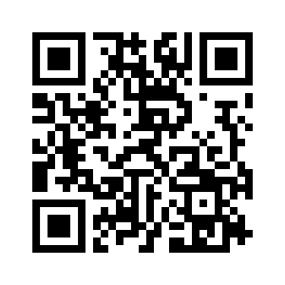
Don’t Forget to mark your Attendance!

Slide 38
Group Photograph

Slide 39





Thank You

